Slide 1
Election Sentiment Analysis Through Natural Language Processing of Political Discourse
Group 35
Submission 5
Kadir Hasan (20101332)
Kaji Sajjad Hossain (20101321)
MD Zubairul Islam (20101322)
Noshin Tabassum (20101347)
Instructed by: Annajiat Alim Rasel
RA and ST: Sabbir & Mehnaz

Slide 2
OUTLINE
INTRODUCTION
RELATED WORKS
OVERVIEW OF DATASET
METHODOLOGY
RESULT ANALYSIS
FUTURE WORK PLAN
CONCLUSION

Slide 3
INTRODUCTION
The research uses advanced natural language processing (NLP) to analyse political rhetoric during elections with the goal of predicting the election winner.
Sentiment analysis is important for assessing public opinion since social media platforms—especially Twitter—are active hotspots for discourse linked to the upcoming election.
Election-related discussions on social media offer a valuable dataset reflecting diverse viewpoints and sentiments.
NLP-driven sentiment analysis provides a means to extract, analyze, and interpret sentiments from this extensive political discourse.
Our objective is to analyze the sentiment of people throughout the election by using various Natural Language Processing techniques.

Slide 4
RELATED WORKS
This paper employs natural language processing, including Latent Dirichlet Allocation and K-means clustering, to analyze social media behavior during the 2022 Philippines Presidential Election, revealing key narratives and achieving 73% accuracy in sentiment analysis with Support Vector Machine.
Solitana et al. [2] did analysis of Twitter posts for 2016 Philippines Presidential Election where word bubbles were generated to identify hate and non hate speeches with K-means clustering. Result shows that, 53% of non hate and 47% of hate tweets has been scraped which indicates non hate tweets dominates towards the election candidates.
This study [3] contributes to the dynamic domain of computational linguistics and political discourse analysis, in which prior research has utilized text analysis techniques such as TF-IDF, PCA, and LDA to identify recurring patterns and trends in political discourse. Previous inquiries have focused on analyzing the communication strategies employed by candidates, recognizing significant themes, and distinguishing linguistic patterns that distinguish political speakers.
The research[4] shows that twitter sentiment analysis data with the VADER model can predict the result of the United State’s president election. The result obtained from this sentiment analysis are not entirely similar to the actual result, but the overall result can represent Joe Biden’s victory over Donald Trump.

Slide 5
OVERVIEW OF DATASET
Data Origin: Derived from Twitter through APIs like "status_lookup" and "snsscrape" using election-related keywords.
Temporal Aspect: Spanning October to November 2020, capturing the evolving discourse around the election.
Contents: Approximately 958,580 tweets were fetched and analyzed, specifically mentioning "Donald Trump" and "Joe Biden."
Features: Main attributes included "tweet" (full tweet text), "likes," "source" (utility used for posting), "user_location," "city," and "country."
Objective: The dataset aimed to explore the correlation between Twitter sentiment and the eventual election results.
Analysis Focus: Considerations included whether tweets could influence or predict election outcomes, including state-wise analysis.
Data Processing: Features underwent preprocessing, including data cleaning, and irrelevant columns like "tweet_id," "collected_at," and "user_description" were removed.
Data Integration: Separate datasets for Trump and Biden were merged for comprehensive analysis.
Visualization: The combined dataset was visually analyzed to understand tweet counts under different scenarios for both Trump and Biden.

Slide 6
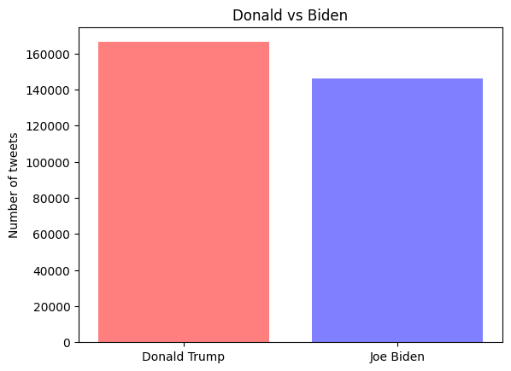

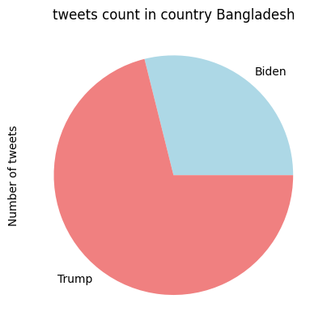
DATASET VISUALIZATION
Fig: No. of Tweets Between Candidates Fig: No of Likes Between Candidates Fig: Tweets Count in Bangladesh
Fig: No. of Tweets Between Candidates

Slide 7
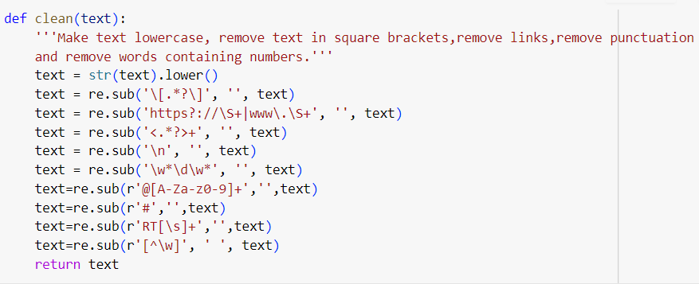
DATA PRE- PROCESSING GLIMPSE

Slide 8
METHODOLOGY
Data Preprocessing:
Merged and cleaned data from Biden and Trump CSV files.
Visualized tweet counts, likes, and user locations for insights.
Sentiment Analysis Models:
TextBlob:
Utilized TextBlob in Python for sentiment analysis, extracting sentiments (positive, negative, neutral) from tweets related to both Trump and Biden datasets by assessing polarity and subjectivity.
BERT:
Utilized Google's advanced BERT deep learning model for bidirectional sentiment analysis of text, comprehensively assessing sentiments (negative and positive) in the 'ClearTweet' column of the dataset.
VADER:
Implemented the VADER intensity analyzer by initializing libraries and defining a function to assign sentiment scores (positive, negative, neutral) based on compound scores, stored in a new column aligned with 'ClearTweet' for subsequent visualization.

Slide 9
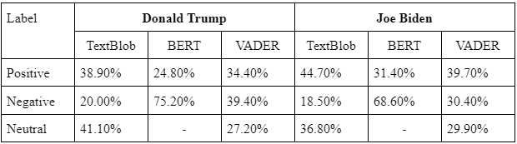
RESULT ANALYSIS

Slide 10
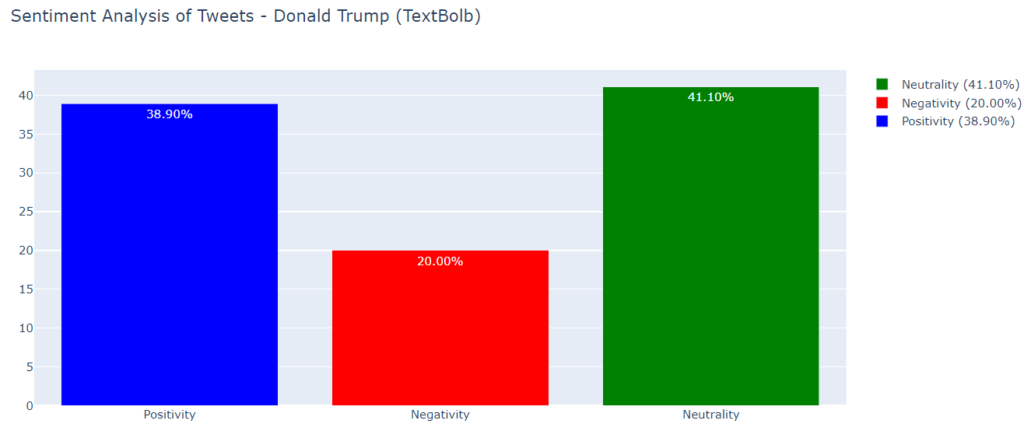
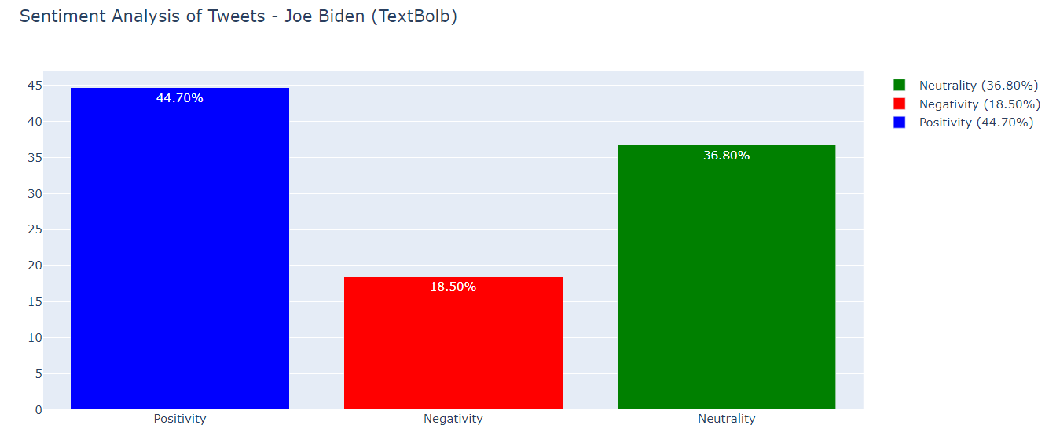
RESULT COMPARISON USING TEXTBLOB
Fig: Sentiment Analysis of Tweets(Donald Trump) Fig: Sentiment Analysis of Tweets(Joe Biden)

Slide 11
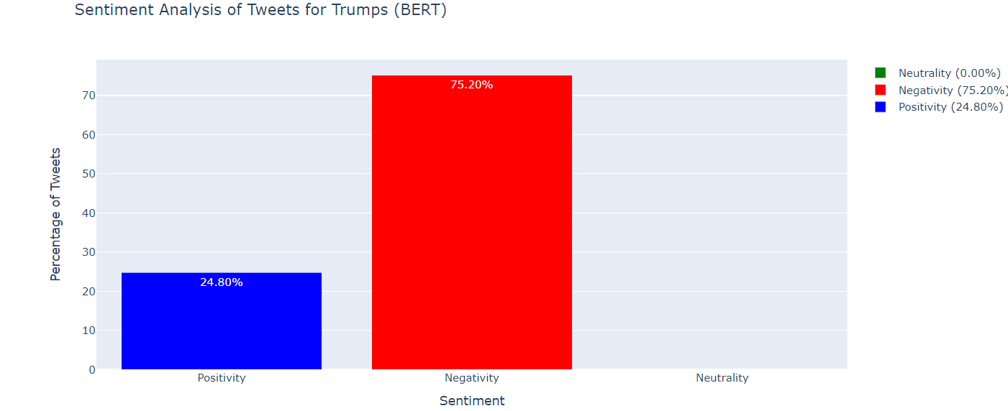
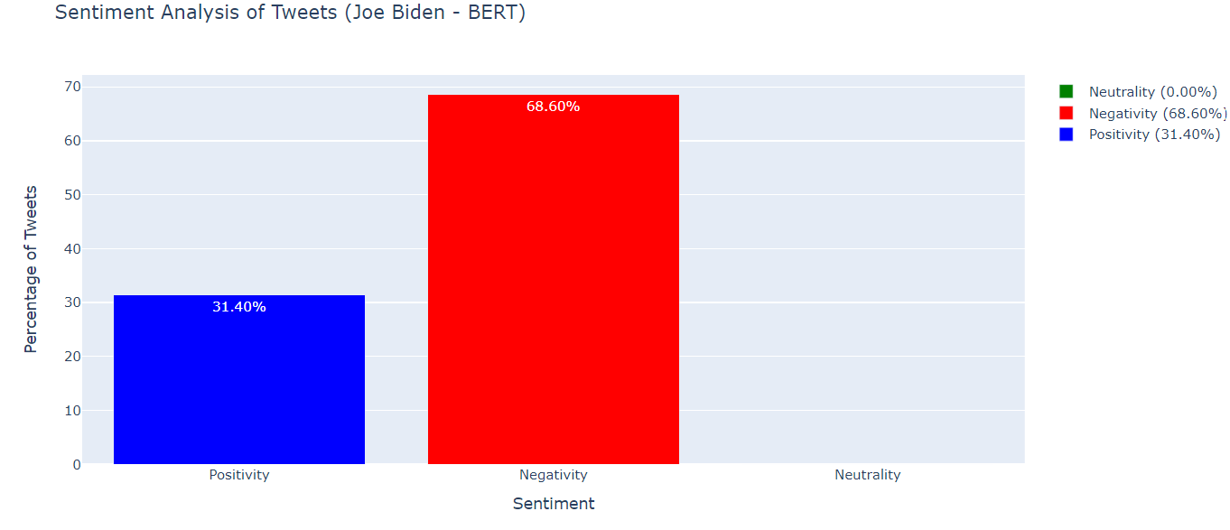
RESULT COMPARISON USING BERT
Fig: Sentiment Analysis of Trump(BERT) Fig: Sentiment Analysis of Joe Biden

Slide 12
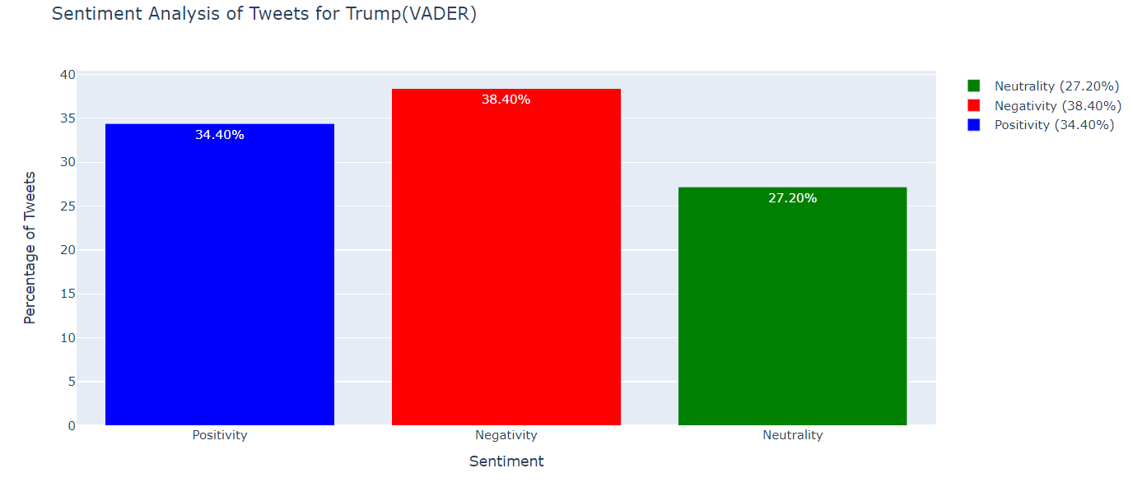
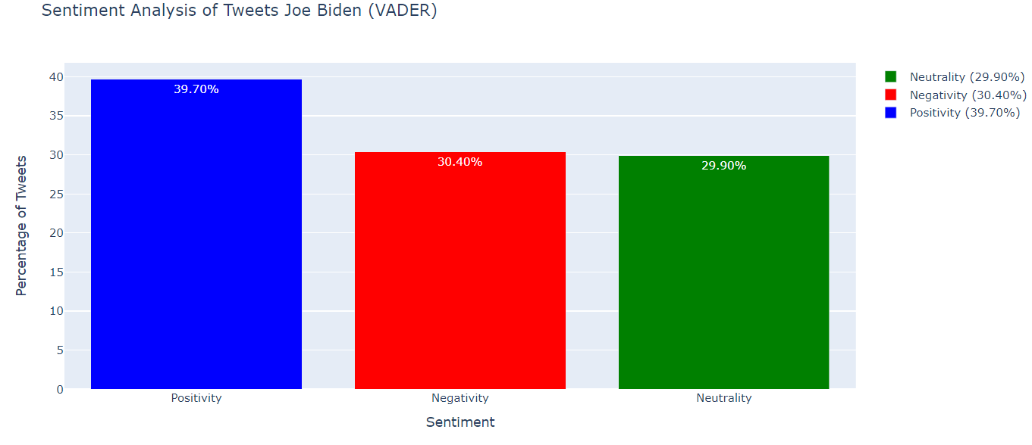
RESULT COMPARISON USING VADER
Fig: Sentiment Analysis of Trump(VADER) Fig: Sentiment Analysis of Joe Biden(VADER)

Slide 13
FUTURE WORK PLAN
Cross-Linguistic Analysis: Expand analysis to include sentiment analysis in different languages or multilingual sentiment analysis to cater to diverse user bases.
User Behavior Analysis: Analyze user engagement metrics (retweets, replies, user influence) to understand the impact of influential users or communities on sentiment.
Multiple Platform Data Analysis: Analyze data not only from the twitter data rather than other social media platforms like Facebook, Reddit, Instagram etc. We can as well work analyzing data from newspaper and speech of people.

Slide 14
CONCLUSION
Utilized various features within the dataset for analysis purposes. Applied visualization methods to understand and visualize tweet counts, sentiments, and other key attributes related to both candidates.
Explored correlations between sentiment trends observed on Twitter and potential implications for the election outcomes, aiming to understand if sentiments influenced or reflected the electoral behavior.
This research work emphasizes the need for continuous exploration, refining methodologies, and employing advanced techniques to gain deeper insights into the role of social media sentiments in elections.

Slide 15
THANK YOU

